Slide 1
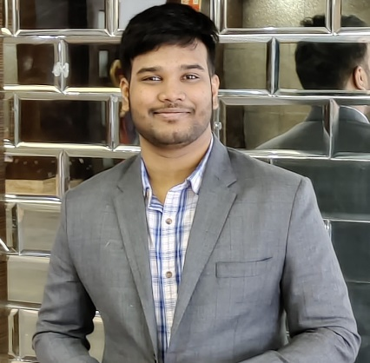



Roshan Kumar Behera
Analyst/Software Engineer
Bachelor of Engineering
Electronics and Communication Engineering : 2018 - 2022
Skills Java 11
Spring Boot
Spring MVC
MERN Stack
ReactJS
MongoDB
Cloud Technologies
AWS CCP
Web Technologies
HTML5
CSS3
JavaScript
Add-ons
GitHub
Postman
Additional Details
Flexibility
Excellent Communication Skills
Responsible & Dedicated
Chennai
ROSHAN.KUMAR-BEHERA@CAPGEMINI.COM
+91 9003367361
A4
Software Engineer who is Strong in design and integration with intuitive problem-solving skills. Passionate about implementing and launching new projects.
Ready to learn new technologies and implement them to further improve my knowledge.
Eager to work in a team of dedicated people and serve a key role in the enhancement and development of the project.
Has working knowledge on ReactJS(Hooks, redux)and Java Microservice Development using Spring framework on an intermediate level.
Have knowledge about AWS and its fundamentals, when and where AWS can be used.
Flight Booking System
Completed end to end case study of Flight Booking System along with JWT authentication, Swagger using MERN Stack applications such as MongoDB, ReactJS. React Bootstrap used for designing user interface.
Completed “AWS Certified Cloud Practitioner Certificate(AWS CCP)”
Completed the course and have achieved the certificate with necessary knowledge and have understanding about AWS Fundamentals .
GCP Cloud Digital Leader Certified
Have completed and achieved Google Cloud Platform “Cloud Digital Leader” certificate and have learnt all the needed services in Google Cloud Platform.
Check out my work on GitHub & Video Profile

